Slide 1
IN CHAPTER 1 : WE LEARNED HOW TO CREATE TYPES
Type Point = {x:number; y:number}
Create a type
Use the type anywhere
function distance(Point p1, Point p2) : number {
return Math.sqrt( (p2.x – p1.x)**2 + (p2.y – p1.y)**2)
}

Slide 2
1
Typed languages
6
Polymorphism
OOP
2
Object/Class
5
Inheritance
3
Aggregation
4
Encapsulation

Slide 3

SAME SAME
DATA
ACTIONS
ATTRIBUTES
FUNCTIONS
PROPERTIES
METHODS

Slide 4


PRACTICE
ACTIVITY
15 MIN
TEAM 3
ACTIONS
PROPERTIES
Notes:
FOR TRAINERS
Jus ask students to select 1 to 3 examples
Objective s : they should understand and explain the difference btw PROPERTIES and ACTION
Important : ACTION need to have an impact on PROPERTIES

Slide 5

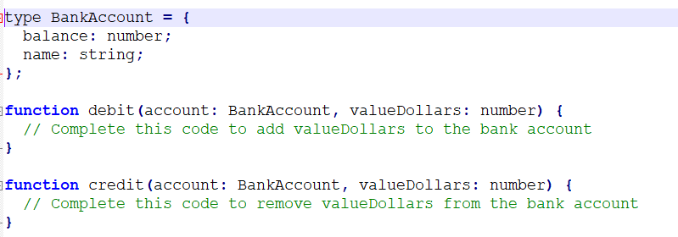
PRACTICE
ACTIVITY 2
10 MIN
INDIV
We have coded a BankAccount using a type
>> Complete missing code to add (credit) or remove (debit) money from an account

Slide 6
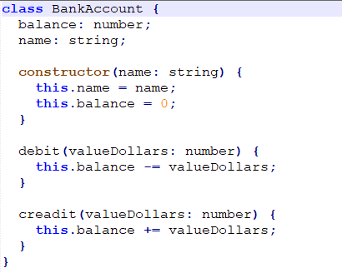
DEMO
Let’s move our BankAccount from Type to Class

Slide 7

A class defines the attributes of a specific object
And the actions to perform on this object
color
fuel
speed
Attributes of the car
drive()
addFuel()
stop()
Methods of the car

Slide 8
CLASS
The main keywords of a Class !!
class BankAccount {
balance: number;
name: string;
constructor(name: string) {
this.name = name;
this.balance = 0;
}
debit(valueDollars: number) {
this.balance -= valueDollars;
}
}
CLASS keyword to define a class

Slide 9
CONSTRUCTOR
The main keywords of a Class !!
class BankAccount {
balance: number;
name: string;
constructor(name: string) {
this.name = name;
this.balance = 0;
}
debit(valueDollars: number) {
this.balance -= valueDollars;
}
}
CONSTRUCTOR keyword
As the entry function when
Objects of this class are created
It’s like a function, but called when
Objects from this model are
Created !!

Slide 10
The main keywords of a Class !!
THIS
class BankAccount {
balance: number;
name: string;
constructor(name: string) {
this.name = name;
this.balance = 0;
}
debit(valueDollars: number) {
this.balance -= valueDollars;
}
}
Attributes
THIS keyword is used to access
To the attribute of the object

Slide 11
“The best functions are those without parameters”
UNCLE BOB

Slide 12
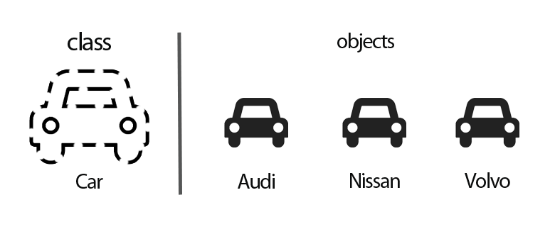
Form 1 model (the class) you can create many variation (objects)

Slide 13
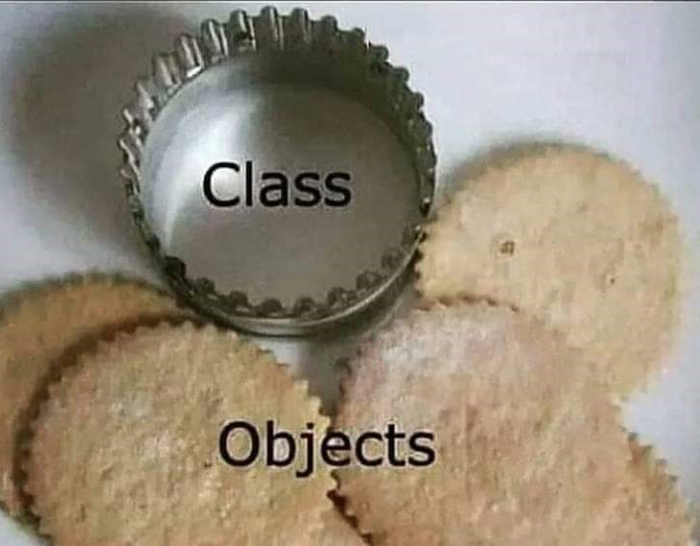

Slide 14
How to create an object from a class ?
Let myPoint = new Point(40, 30);
class Point {
x: number;
y: number;
constructor(x: number, y: number) {
this.x = x;
this.y = y;
}
}
1
Call the constructor of Point
By using the keyword NEW

Slide 15
How to create an object from a class ?
Let myPoint = new Point(40, 30);
class Point {
x: number;
y: number;
constructor(x: number, y: number) {
this.x = x;
this.y = y;
}
}
2
The constructor will return
A new object Point
With the X and Y values assigned
With the parameters (40 and 30

Slide 16
How to create an object from a class ?
Let myPoint = new Point(40, 30);
class Point {
x: number;
y: number;
constructor(x: number, y: number) {
this.x = x;
this.y = y;
}
}
{x: 40, y: 30 }
3
The object is returned

Slide 17
new is the keyword to create objects from
Class definitions
Let myCar = new Car(“audi”);

Slide 18

PRACTICE
ACTIVITY
30 MIN
TEAM 2
GAME
HOUSE

Slide 19
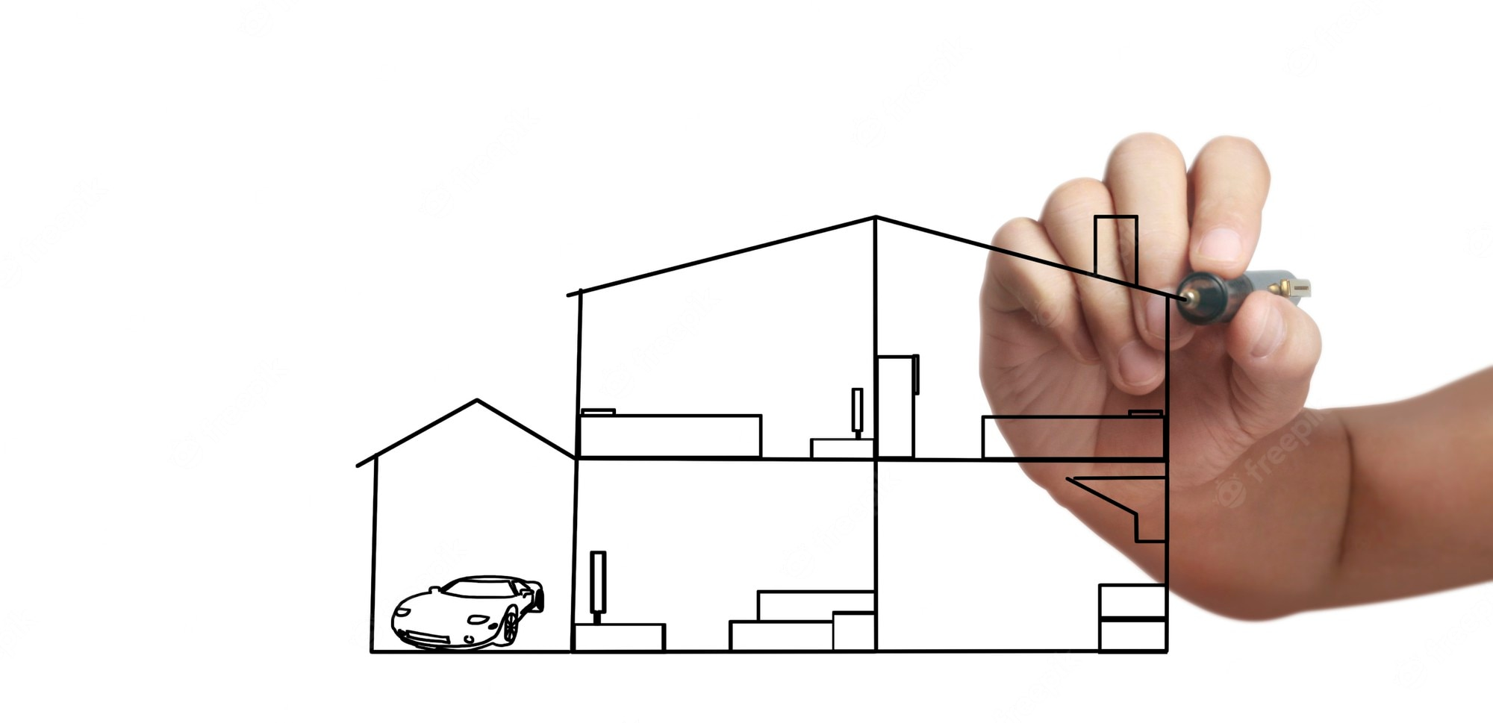
PRACTICE
ACTIVITY
15 MIN
TEAM 4
Step 1 : Each member draw their dream house o paper
HOUSE
DREAM

Slide 20
PRACTICE
ACTIVITY
15 MIN
TEAM 4
Step 2 :
Look at the 4 plans of dream houses :
What do they have in common ?
What are their differences ?
Find the model (the CLASSES) that can implement the 4 dream houses

Slide 21
the “functional” word
the “Object” word
type Point = {
x: number;
y: number;
};
function isEqualTo(p1: Point, p2: Point): boolean {
return p1.x == p2.x && p1.y == p2.y;
}
let point1: Point = { x: 40, y: 40 };
let point2: Point = { x: 40, y: 40 };
console.log(isEqualTo(point1, point2));
class Point {
x: number;
y: number;
constructor(x: number, y: number) {
this.x = x;
this.y = y;
}
isEqualTo(other: Point): boolean {
return this.x == other.x && this.y == other.y;
}
}
let point1 = new Point(40, 30);
let point2 = new Point(40, 30);
console.log(point1.isEqualTo(point2));

Slide 22

HOMEWORK : ANSWER QUESTIONS
Q1 : what is the difference between a class and an object ?
Q2 : what is the difference between a class and a type ?
Q3 : when do we use the keyword ‘this’ ?
Q4 : when do we use the keyword ‘new’ ?
Q5 : how many objects can we create from a class ?

Slide 23

WANT TO GO FURTHER ?
CLASSES & OBJECTS IN TYPESCRIPT
https://www.typescriptlang.org/docs/handbook/classes.html

